Slide 1
Databases

Slide 2
Relational Database

Slide 3
Overview of material
Databases
Relational database (terms and definitions)
Normalisations (1NF, 2NF, 3NF)
Design – entity-relationship modelling
Setting up a database in SQL Server Management Studio
SQL database queries
Coding with LINQ
Software development lifecycle
Coding standards
Project ideas

Slide 4
Fundamental Concepts
Entity and Attributes
Composite Attributes
Multi- Valued Attributes
Primary key, foreign key, composite key

Slide 5
Normalisation
Databases are designed through a process called normalisation
1st normal form
Remove repeating groups
Define data items and put them into tables
Make sure there is a primary key
2nd normal form
Make sure there are no partial functional dependencies on the primary key
3rd normal form
Make sure there is no transitive dependency.
Everything in the table must be related to the (whole) primary key

Slide 6
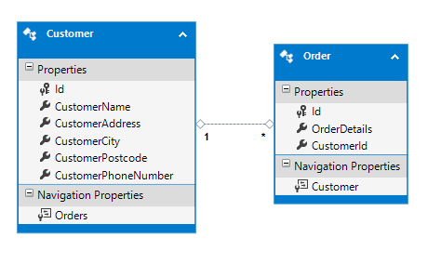
Relational databases
A relational database is a collection of data, organised as tables which are joined by relationships
The advantage of using relational databases is that data can be extracted in many different ways without reorganising the database

Slide 7
Features of a relational database
Tables
Each has fields which contain data
Each has a primary key
Relationships
1:1
1:M
M:N
Made by connecting the keys from different tables
M:N should be resolved.
Primary key
Foreign key

Slide 8
Database design example
Customers and orders
Design two tables to put data like this into a database
Customer
Acme Explosives
1 Coyote Street
Toontown
NW13 6AB
Ph: 020 8456 1234
Ph: 020 8456 2345
Order
Customer Name
Customer Address
Date
5 fuses
10 sticks of dynamite
1 box of matches
Total

Slide 9
Database design exercise
Do a relational database design for a primary school that shows the relationship between teachers, classes and pupils
Use 1st, 2nd and 3rd normal form to improve your database design
Work out whether the relationships between the tables are 1:1, 1:many or many:many
Please assume that every teacher teaches all subjects to one class, i.e. there are no specialist subject teachers

Slide 10
SQL

Slide 11



SQL
Structured Query Language
Designed for managing data in relational database management systems
Originally developed by Donald Chamberlin and Raymond Boyce in 1974
Declarative language (4GL) with procedural elements
Open source
Also commercial versions by IBM, Oracle, Microsoft and others
Only minor differences between versions

Slide 12
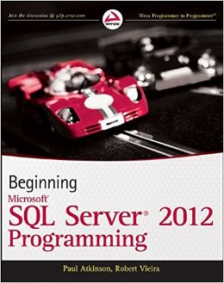
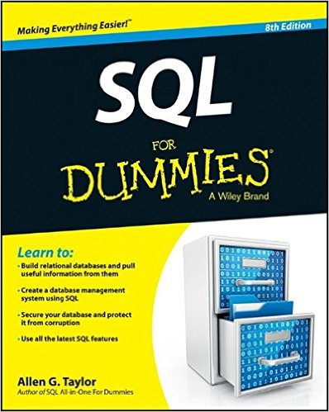
SQL reference material
Beginning Microsoft SQL Server 2012 Programming
Aimed at professional programmers
Covers T-SQL (the Microsoft version of SQL)
Microsoft SQL
https://www.techonthenet.com/sql_server/index.php
SQL for Dummies
Very accessible
Not Microsoft
Online tutorial with SQL interpreter
http://www.sqlcourse.com
W3 Schools
https://www.w3schools.com/sql/default.asp

Slide 13
SQL conventions
Keywords are in capitals (even though SQL is not case-sensitive)
e.g. CREATE, INSERT
Text and date values are in single quotes and numbers aren’t
Don’t put spaces in table or column names – it’s asking for trouble

Slide 14
SQL commands
CREATE DATABASE <databaseName>
USE <databaseName>
CREATE TABLE <tableName>
(<columnName> <dataType> <constraints>),
(<columnName> <dataType> <constraints>)
INSERT INTO <table name>
(<columnName>, <columnName>, <columnName>)
VALUES
(‘value1’, ‘value2’, 99)

Slide 15
SQL commands
ALTER TABLE <tableName>
ADD
<columnName> <dataType> <constraint>
UPDATE <tableName>
SET <columnName> = ‘value1’
WHERE <columnName> <condition>
SELECT <list>
FROM <tableName>
WHERE <columnName> <condition>
DELETE <columnName>
FROM Products
DROP <tableName>
DROP <databaseName>
Joins:
SELECT <list>
FROM <tableName>
INNER JOIN <tableName>
ON <join condition>
SELECT <list>
FROM <left table>
<LEFT or RIGHT> [OUTER] JOIN <right table>
ON <join condition>

Slide 16
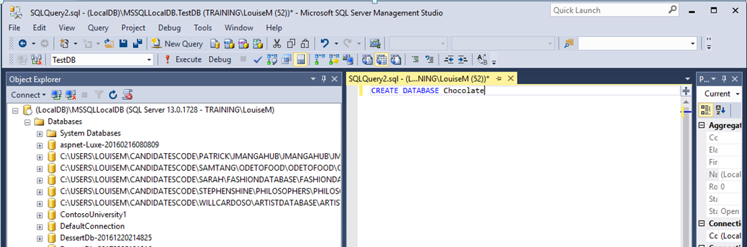
Creating a database (select MSSQLLocalDB)
1. Click on the New Query button
2. In the Query window type
CREATE DATABASE Chocolate
3. Click on the Execute button

Slide 17
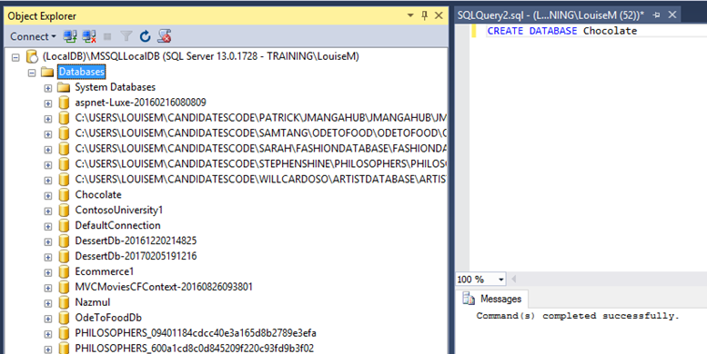
Creating a database (2)
The new database appears under the database node (you may have to refresh several times and collapse and expand the database node to see it)
A message appears below the query window

Slide 18
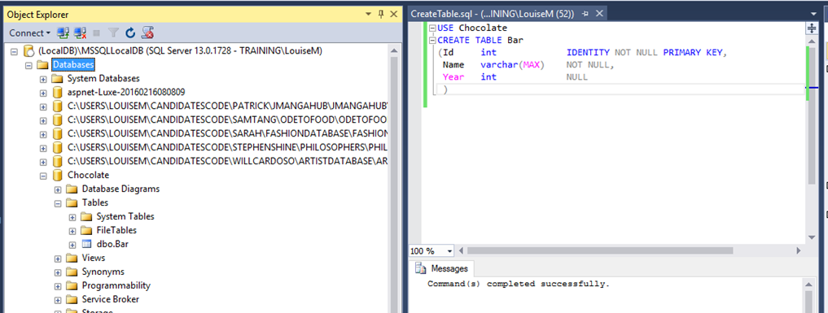
Creating a table
In the query window, enter the following:
USE Chocolate
CREATE TABLE Bar
(Id int IDENTITY NOT NULL PRIMARY KEY,
Name varchar(MAX) NOT NULL,
Year int NOT NULL
)
The table will then appear under the node for the database (again, this may need lots of refreshing)

Slide 19
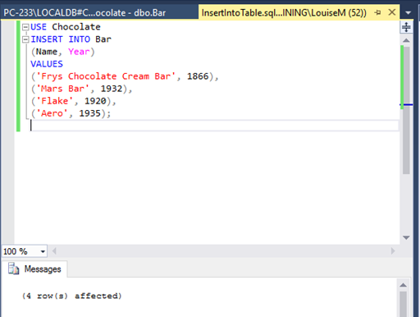
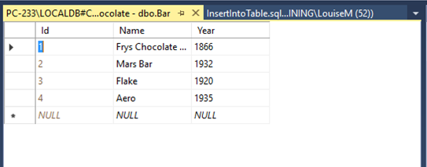
Inserting data into a table
In the query window, enter:
USE Chocolate
INSERT INTO Bar
(Name, Year)
VALUES
('Frys Chocolate Cream Bar', 1866),
('Mars Bar', 1932),
('Flake', 1920),
('Aero', 1935);
Click Execute and then
Right-click on the table name
Select Edit top 200 rows

Slide 20
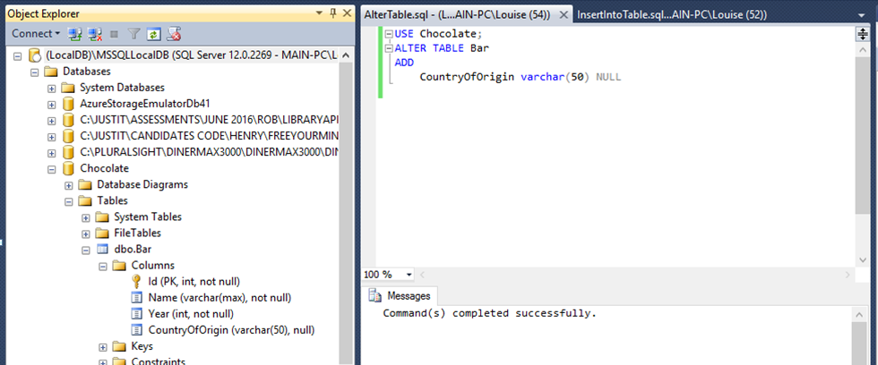
Adding an extra column to a table
To add an extra column to the table,
run the following query:
USE Chocolate;
ALTER TABLE Bar
ADD
CountryOfOrigin varchar(50) NULL
Expand the Columns node to see the result

Slide 21
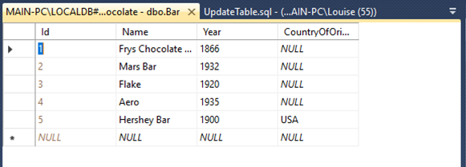
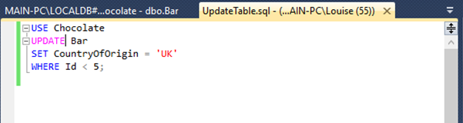
Updating tables
We can now insert a chocolate bar with its country of origin:
USE Chocolate
INSERT INTO Bar
(Name, Year, CountryOfOrigin)
VALUES
('Hershey Bar', 1900, 'USA')
giving this result
To update existing records:
USE Chocolate
UPDATE Bar
SET CountryOfOrigin = 'UK'
WHERE Id < 5;

Slide 22
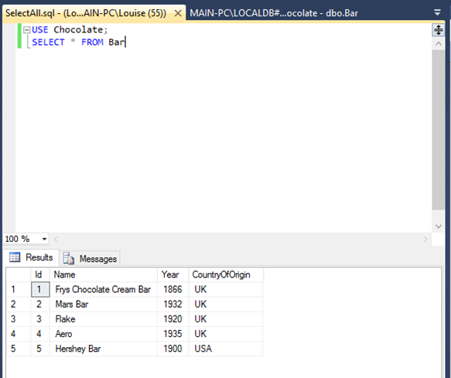
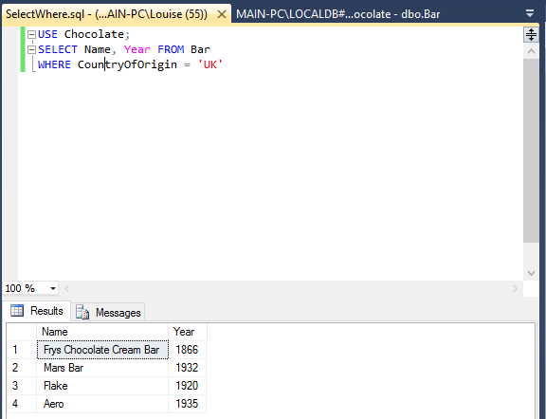
SELECT statement
USE Chocolate;
SELECT * FROM Bar
selects everything from the table
The columns or records returned can be chosen:
USE Chocolate;
SELECT Name, Year FROM Bar
WHERE CountryOfOrigin = 'UK'

Slide 23
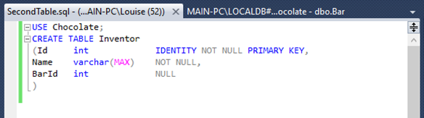
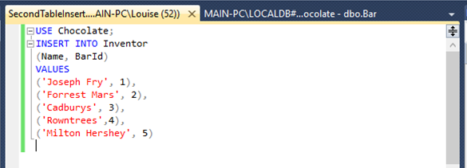
Adding a table and more data
Add another table:
USE Chocolate;
CREATE TABLE Inventor
(Id int IDENTITY NOT NULL PRIMARY KEY,
Name varchar(MAX) NOT NULL,
BarId int NULL
)
Insert some data:
USE Chocolate;
INSERT INTO Inventor
(Name, BarId)
VALUES
('Joseph Fry', 1),
('Forrest Mars', 2),
('Cadburys', 3),
('Rowntrees',4),
('Milton Hershey', 5)

Slide 24
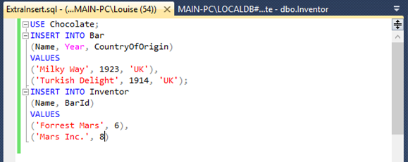
Adding a table and more data (2)
Now insert the following data (you may notice that the tables no longer match up perfectly, but that is deliberate):
USE Chocolate;
INSERT INTO Bar
(Name, Year, CountryOfOrigin)
VALUES
('Milky Way', 1923, 'UK'),
('Turkish Delight', 1914, 'UK');
INSERT INTO Inventor
(Name, BarId)
VALUES
('Forrest Mars', 6),
('Mars Inc.', 8)

Slide 25
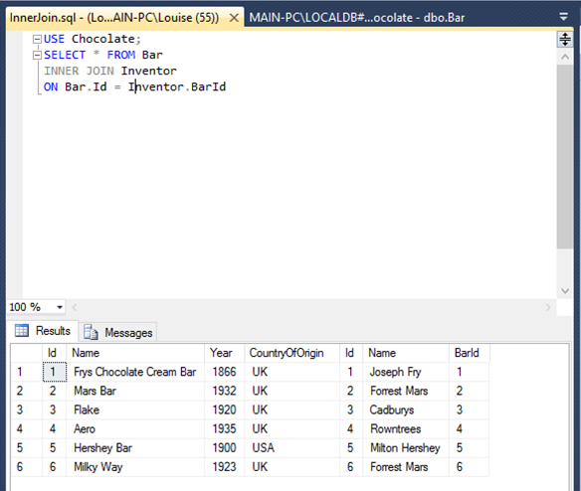
Inner joins
Run the following query:
USE Chocolate;
SELECT * FROM Bar
INNER JOIN Inventor
ON Bar.Id = Inventor.BarId
Inner join includes multiple matches and excludes any rows that don’t match

Slide 26
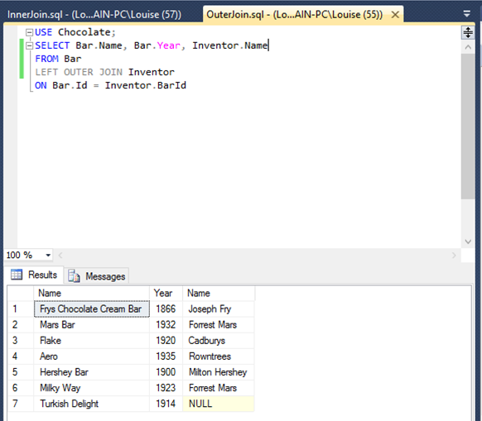
Outer join - left
Run the following query:
USE Chocolate;
SELECT Bar.Name, Bar.Year, Inventor.Name
FROM Bar
LEFT OUTER JOIN Inventor
ON Bar.Id = Inventor.BarId
Left table
Right table
A left outer join includes unmatched data from the left table

Slide 27
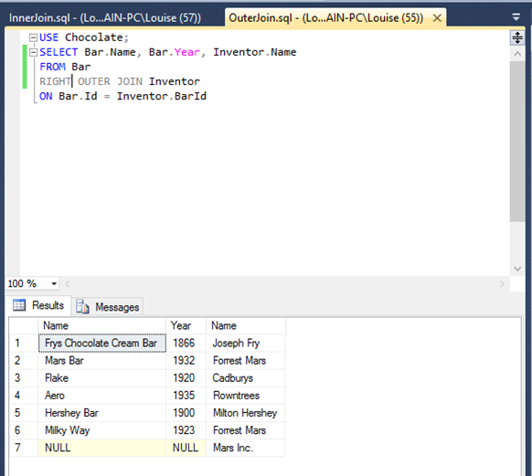
Outer join - right
In the previous query, change LEFT to RIGHT and rerun it. Note the difference in the results

Slide 28
SQL and C# in Visual Studio
If you really want to connect an SQL database to your C# code, then look at this article:
https://www.codeproject.com/Articles/823854/How-to-connect-SQL-Database-to-your-Csharp-program
But first try ADO.NET, as it’s much easier

Slide 29
Summary of SQL
Creating a database and a table
Inserting data
Altering the structure of a table
Updating a table
Selecting data
Inner joins – only retrieve matching records
Left and right outer joins – retrieve matching records, plus non-matching records from either the left or right tables

Slide 30
LINQ
Language Integrated Query Language (LINQ) can be used for database queries
List<Customer> listCustomers = new List<Customer>();
using (FirstDBEntities myEntities = new FirstDBEntities())
{
var customers = from customer in myEntities.Customers
select customer;
listCustomers = customers.ToList();
}

Slide 31
LINQ options
.FirstOrDefault
It is almost the same as First. If a collection is empty, it returns the default value for the type.
.LastOrDefault
Returns the last element from a collection, or the last element that satisfies a condition. Returns a default value if no such element exists.
.SingleOrDefault
The same as Single, except that it returns a default value of a specified generic type, instead of throwing an exception if no element found for the specified condition.
However, it will thrown InvalidOperationException if it found more than one element for the specified condition in the collection.
Orderby
Sorts the elements in the collection based on specified fields in ascending or decending order.
select

Slide 32
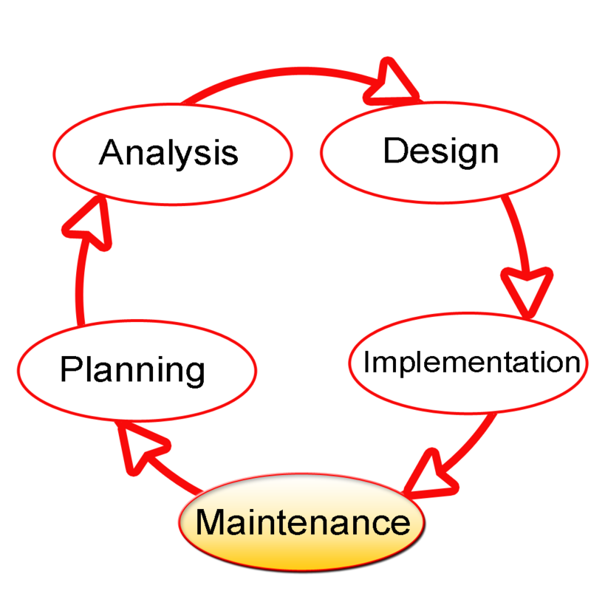
Systems Development Lifecycle
Software engineering method of planning, designing, testing and deploying a computer system
Planning
Feasibility and cost analysis
Analysis of requirements
What should the system do?
Design of system
How should the system do it?
Implementation
coding
Maintenance
Fixing bugs and making changes

Slide 33
Systems development methodologies
Agile
Emphasises adaptive planning, evolutionary development, early delivery, and continuous improvement
Encourages rapid and flexible response to change
Popular
Scrum is an agile methodology
Spiral
Focuses on early identification and reduction of risks via prototyping
Waterfall
Traditional – once each phase is completed there is no going back

Slide 34
Coding standards
Other people need to understand your code
e.g. team members on medium and large projects
And so will you, when you’ve forgotten all about it in a few months’ time
Comments are vital
Explain what’s going on
Can provide a link between the design and the code
At the top of each file put the name of the module, description, your name and date, and details of any changes
In the code, comment each class and method and any bits that are hard to understand

Slide 35
What kind of projects work?
First project should be something straightforward
Second can be a bit more challenging, maybe including a database
Good if projects are deployed on the web (or videoed)
Try to do something that interests you, to make it distinctive and interesting to others

Slide 36
SQL Server and SQL Server Management Studio installation – errors and troubleshooting

Slide 37
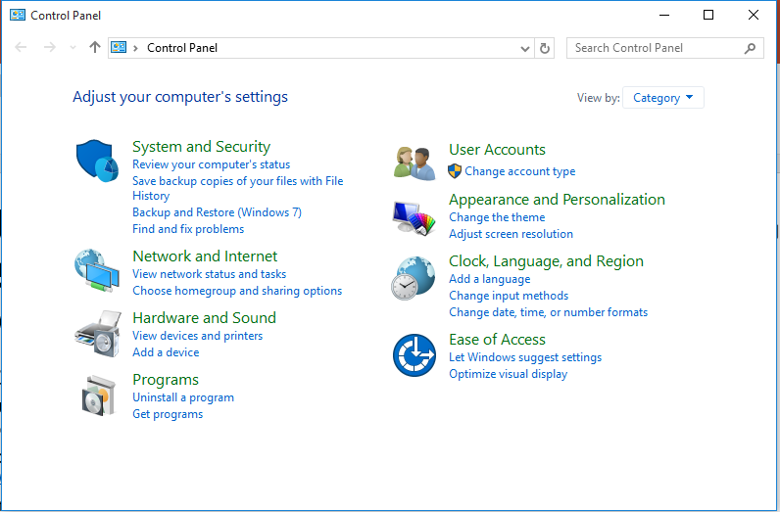
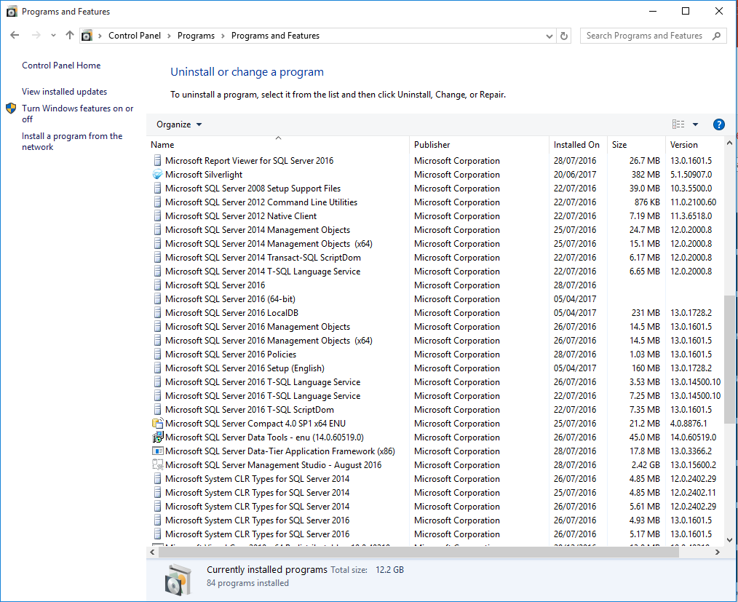
How to remove an old version of SQL Server or SQL Server Management Studio
Before installing a new version of SQL Server or SQL Server Management Studio
You MUST remove any old versions
If you don’t, the new installation may fail
Go to the control panel
To get there, type Control Panel into the Windows search box
Choose Uninstall a Program
For every file beginning with Microsoft SQL Server
Right-click and select Uninstall
BUT if you get a warning about dependencies, don’t go ahead with uninstalling that file
When you have gone through the list once
Press F5 to refresh the list
Uninstall any remaining files beginning with Microsoft SQL Server
BUT if you get a warning about dependencies, don’t go ahead with uninstalling that file
Go through the list again if there are any relevant files left
When there are no files left that begin with Microsoft SQL Server, you are finished and you can install the new versions of SQL Server and SQL Server Management Studio

Slide 38
If you get an error logging into SQL Server Management Studio using LocalDB – 1/2
LocalDB is the best database to use with SQL Server Management Studio
It is easy to deploy
It doesn’t need IIS
If you get an error trying to log in to SQL Server Management Studio using LocalDB you need to run the sqllocaldb utility to fix the problem
This should be included in your SQL Server Express download
To check if you have it, go to the Command Prompt and type sqllocaldb
If it’s not there, you will get an error message saying it wasn’t found
If you don’t have it, ask one of the trainers if they have a copy
Go to the Command Prompt
To find it, type Command Prompt into the Windows search box

Slide 39
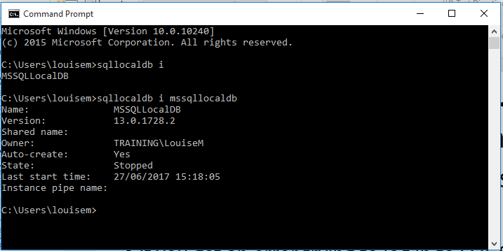
If you get an error logging into SQL Server Management Studio using LocalDB – 2/2
At the Command Prompt
Type sqllocaldb i to find out which databases you have
Type sqllocaldb i mssqllocaldb to get information about mssqllocaldb
If the information shows as on the right, type sqllocaldb start mssqllocaldb and try starting SQL Server Management Studio again and logging in with LocalDB
If there is an error and this information doesn’t display
Type sqllocaldb delete mssqllocaldb
Warning: this will delete all your existing databases, so back them up first
Type sqllocaldb create mssqllocaldb
Try starting SQL Server Management Studio again and logging in with LocalDB

